Slide 1

Dove’s
#TurnYourBack Campaign
SAMANTHA C AND MEGAN R

Slide 2
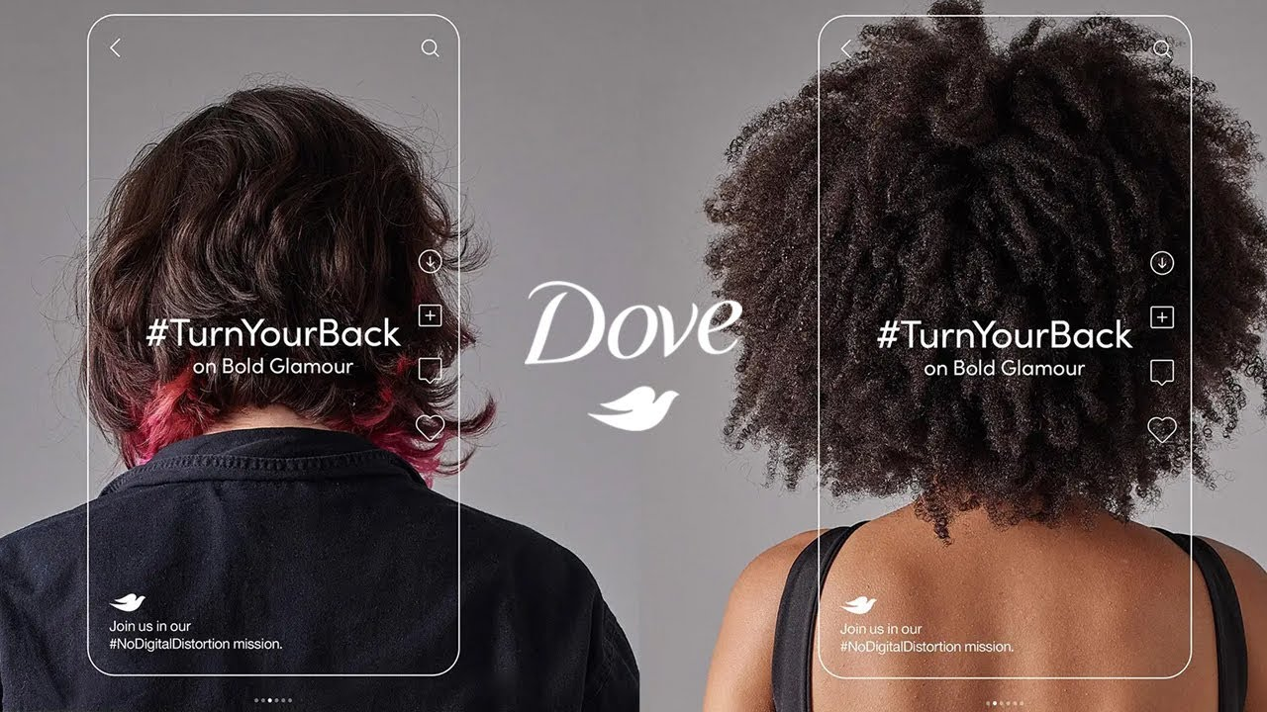
https://youtu.be/pw73tgBmv0g

Slide 3
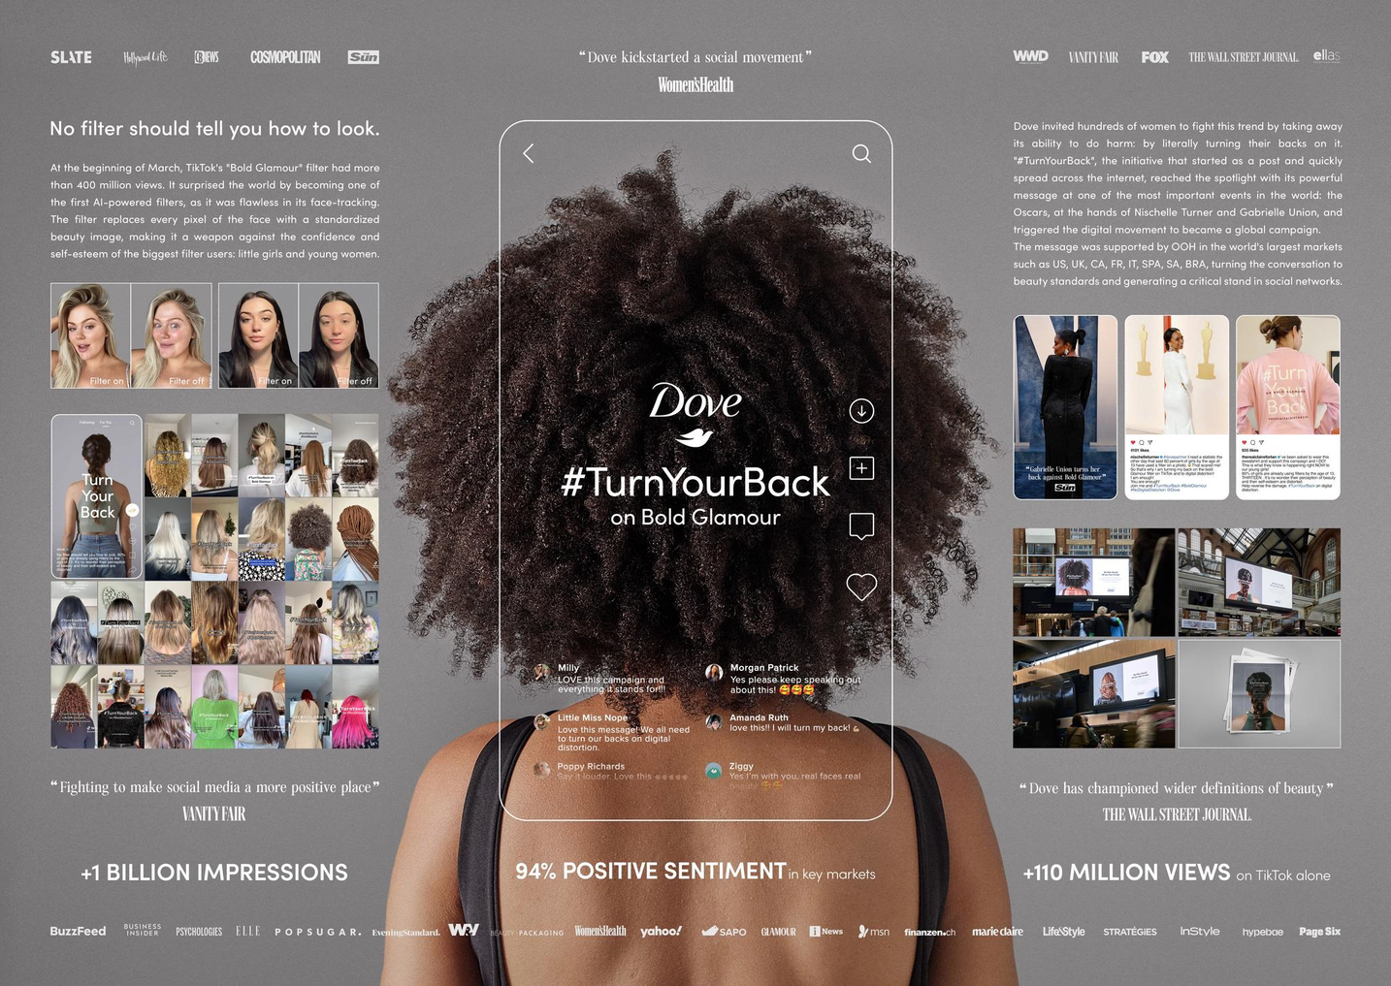
Synopsis of Topic

Slide 4
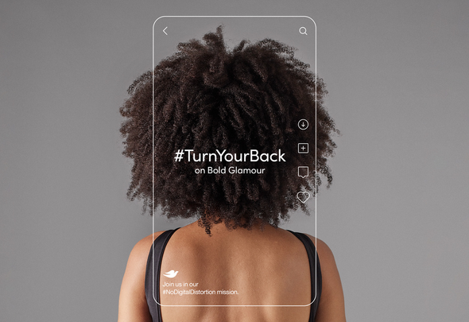
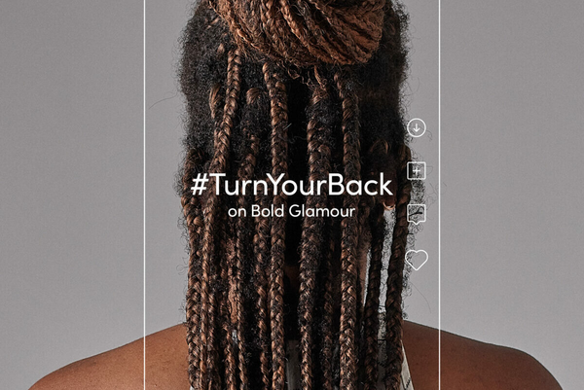
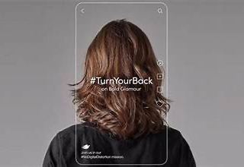
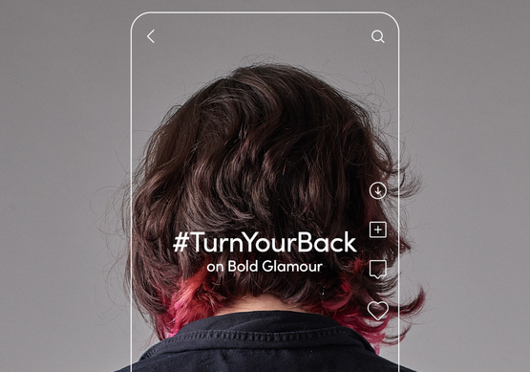
Timeline
Mid 2023
2024 -Campaign Continuation
Late 2023
March 2023
THE BRAND LEADS TO A WIDER PLATFORM OF UNFILTERED IMAGES IN SOCIAL MEDIA, COVERING THE IDEA OF BEAUTY WITHOUT MANIPULATION
THE HASHTAG #TURNYOURBACK GETS OVER 80 MILLION VIEWS ON TIKTOK
DOVE PARTNERS WITH AGENCIES OGILVY AND DAVID TO LAUNCH THE CAMPAIGN
DOVE PARTNERS WITH ORGANIZATIONS TO SUPPORT MENTAL HEALTH AWARENESS, USING #TURNYOURBAC TO PROMOTE POSITIVE CHANGE.

Slide 5
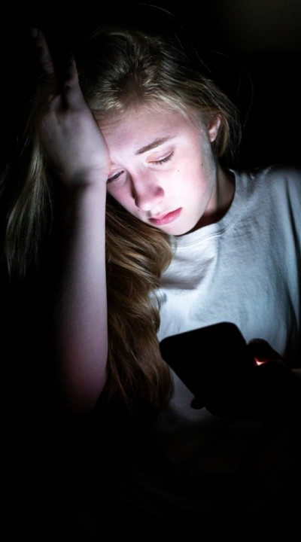
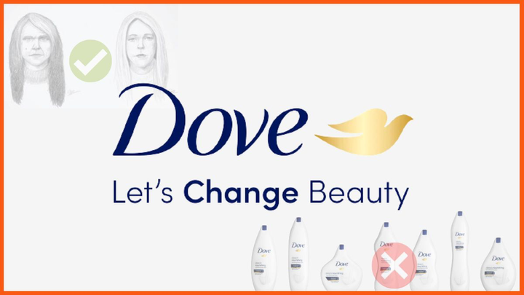
Issues Raised
Dove is challenging beauty standards online
  Dove’s campaign is in response to Tik Tok’s Bold Glamour filter
  Claims have been made that the Bold Glamour Filter promotes impossible beauty standards to obtain
  This is harming inidividual’s self perception of themselves, causing comparison
  This presents a very serious risk to younger generation’s mental health and their self image, as well as their understanding of what “pretty” is

Slide 6
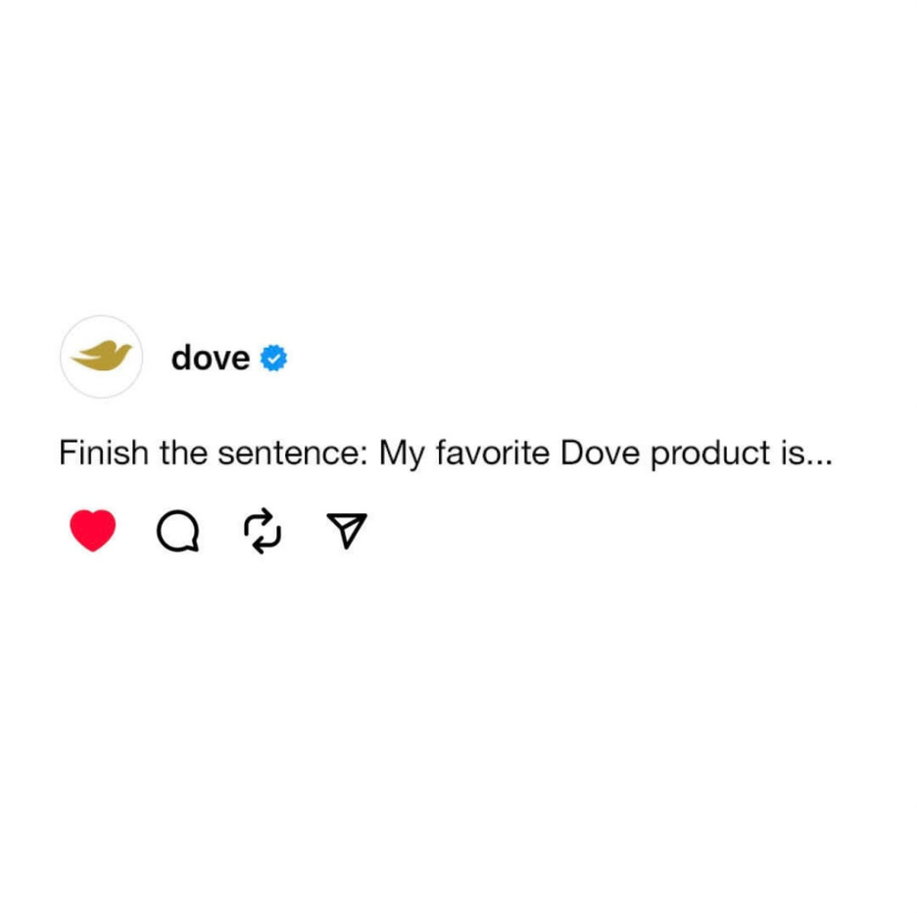
Objectives
  Challenging traditional beauty standards
  Participate in self confidence
  Redefining beauty
  Transparency about beauty and self image

Slide 7
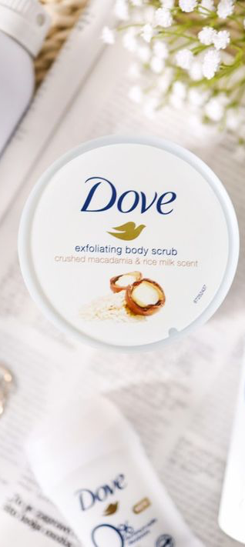
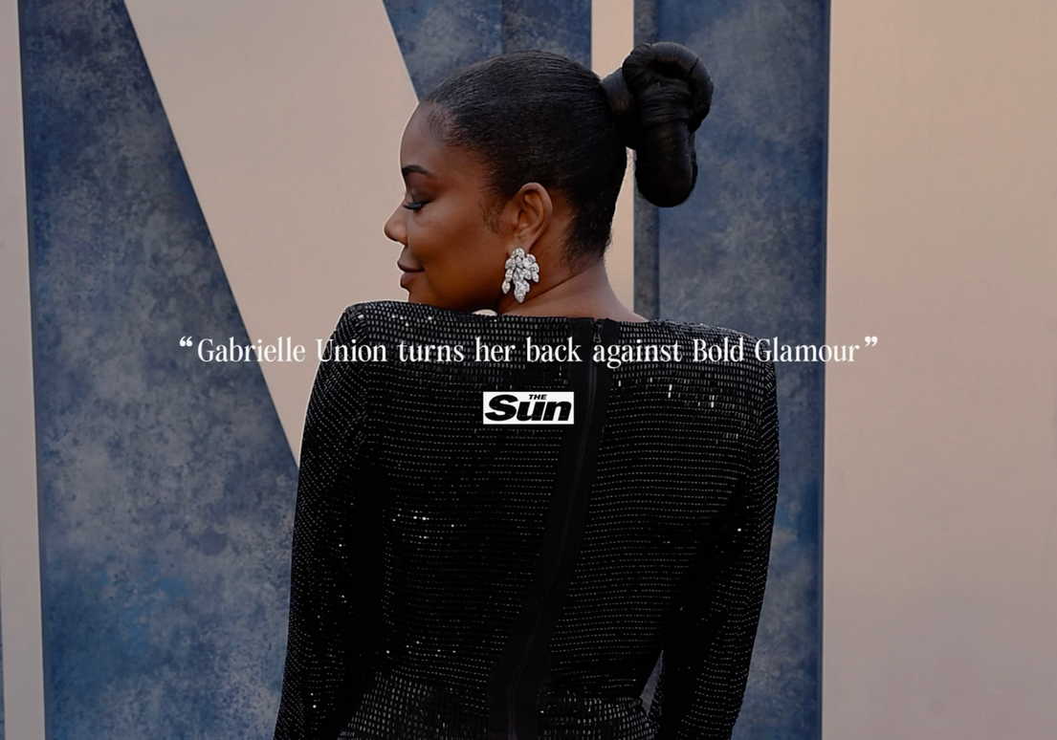
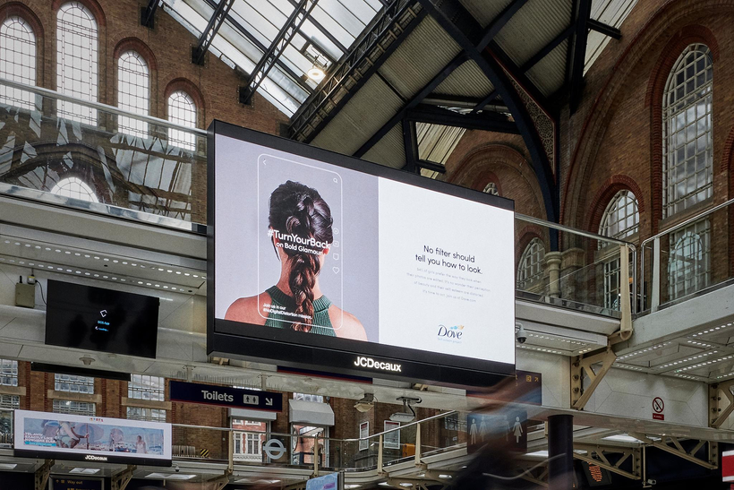
Strategies and Tactics
Value Marketing
  Dove focuses on promoting their values rather than their products in these campaigns. They build connection and trust with their consumers
Use of social media and word of mouth
  Trending online- shares, likes, and comments showing support and opinions
  Tactic: Use of hashtag #TurnYourBack

Slide 8
Strategies and Tactics
Influencer marketing
  The use of celebrities and influencers to help promote the campaign is a great way to gain more attention
  Tactic: Celebrity Gabrielle Union seen showing support for the campaign at Vanity Fair’s Oscars party
Promotional Signs
  Tactic: Busy areas to reach maximum attention

Slide 9

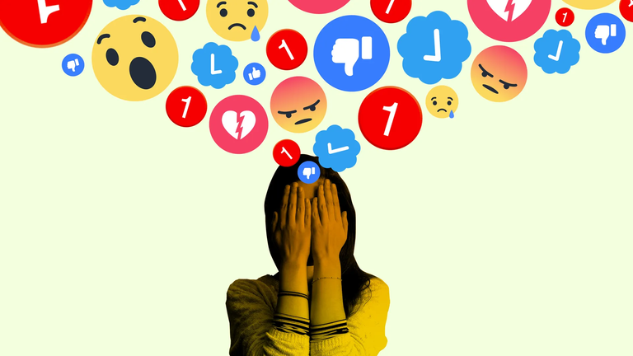
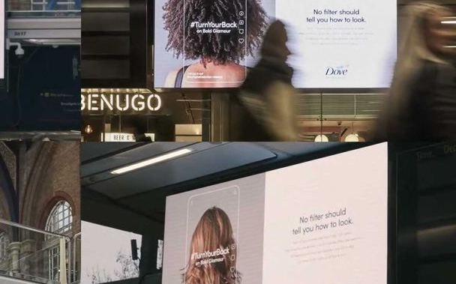
Critical Analysis
VIRAL SUCCESS
MENTAL HEALTH
ORIGINALITY
  Notable characteristics of Dove
  Typically not done by other beauty companies
  80 Million views on tikotk
  Reached large audiences
  “Making it a source of confidence, not anxiety”

Slide 10
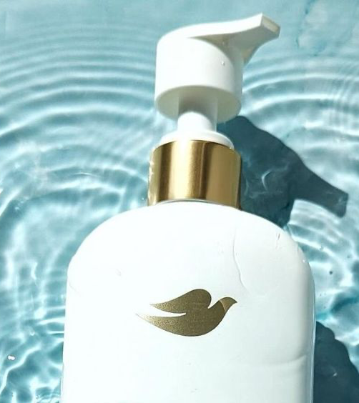
Questions
What are some potential risks of Dove taking a strong stance and power on serious social issues?
What would you have done differently if you were in charge of this campaign?

Slide 11
Sources
Hamza, H., & Hamza, H. (2023, June 23). Turn Your Back: How Dove’s Campaign is Challenging Beauty Standards on Social Media? Brand the Change. https://brandthechange.com/strategy/turn-your-back-how-doves-campaign-is-challenging-beauty-standards-on-social-media/
08
LLLLITL. (2023, June 21). Dove - Turn Your Back (case study) [Video]. YouTube. https://www.youtube.com/watch?v=pw73tgBmv0g

