Slide 1
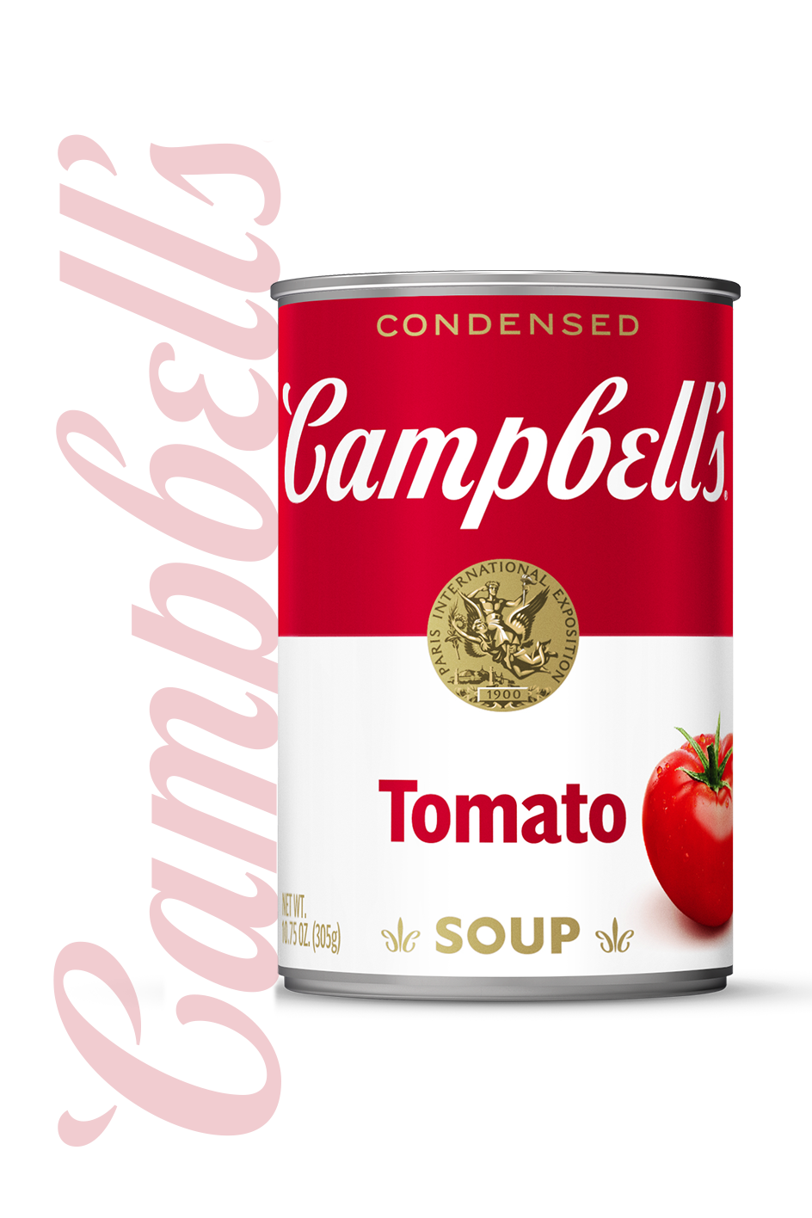
Campbell’s
Campaign Strategy For 2024
Samantha Casey

Slide 2
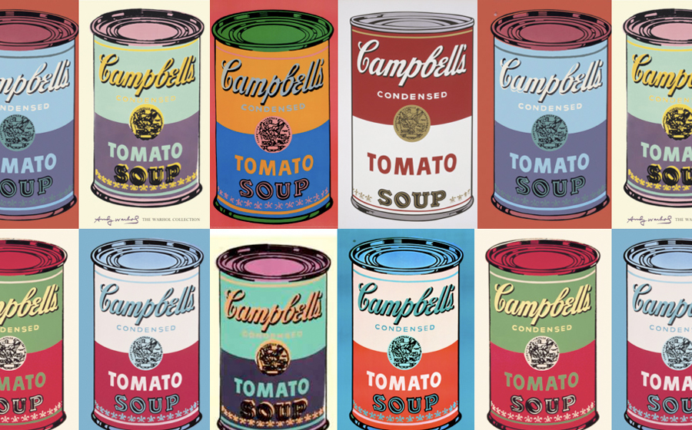
MARKETING CHALLENGE
Strong need for quality deliberate marketing!
Competitors: Progresso and Healthy Choice
When reaching for soup, we want consumers to reach for Campbell’s!

Slide 3
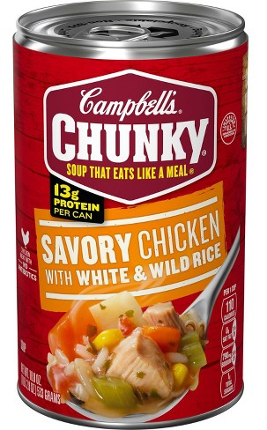
GOALS/ objective
Bring grand awareness to Campbell’s product ‘Chunky Savory Chicken with White and Wild Rice’
Overall coverage for the brand
Creative ways to promote Campbell's products and their name
Showcase soup as fun and fresh again!

Slide 4





Target description - MEET MATT!

Slide 5
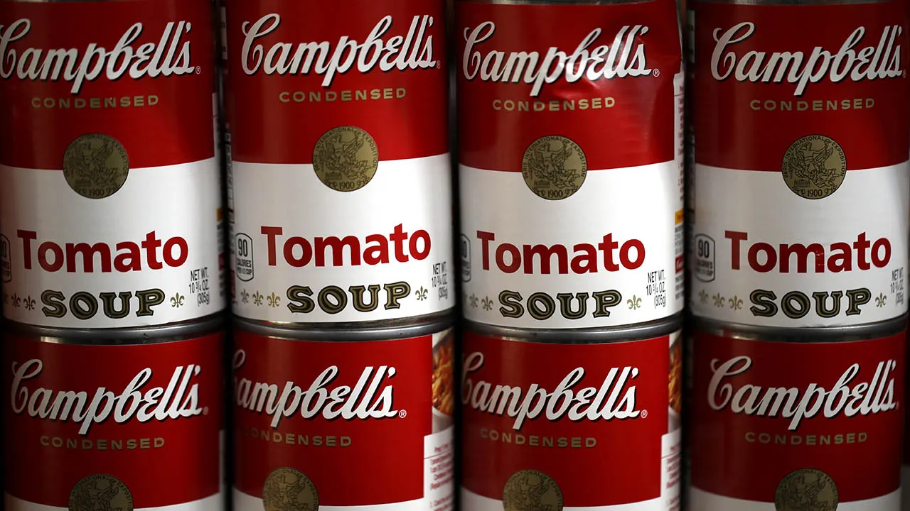
Drivers and Barriers
Drivers:
Top brand
Variety of flavors and styles
Barriers:
Major competition from similar brands
Making soup exciting!

Slide 6
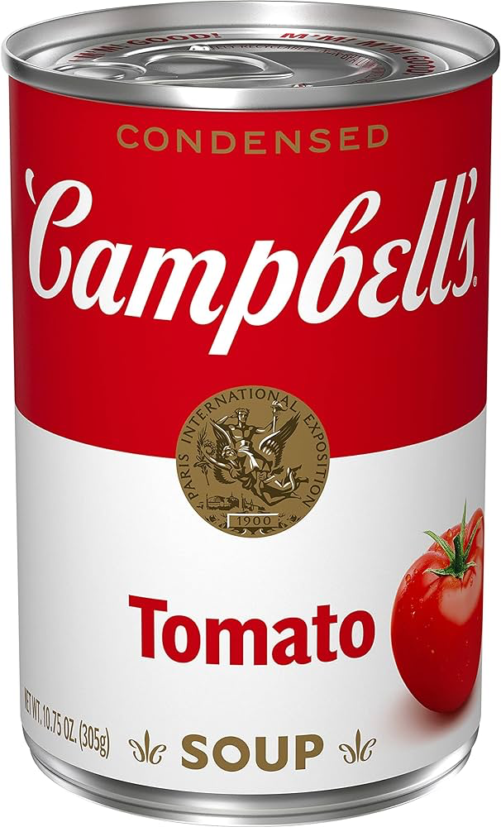
Aperture Opportunities
On the move with Matt
Grocery store
On social media feeds or television commercials after 5pm.

Slide 7
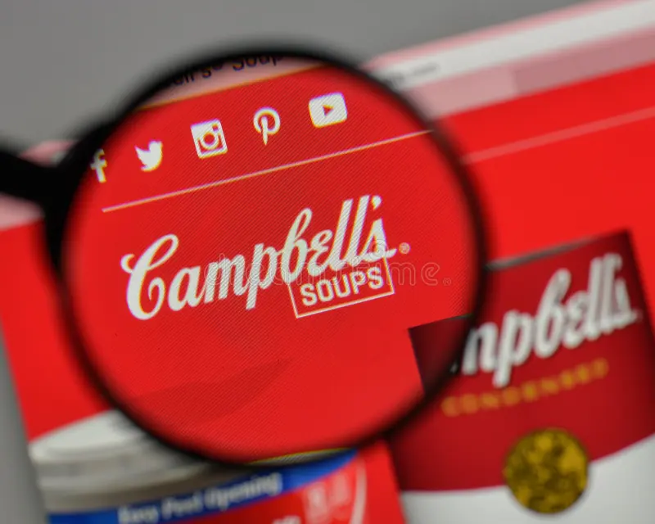
KEY INSIGHTS
Convenience and problem solving are key!
Consumer’s love easy and quick solutions to their problems or needs
Providing consumers with ways to incorporate Campbell’s soup into larger dishes, allows for consumers to want to purchase Campbell’s when making other dishes than just wanting soup

Slide 8



Strategy
Social media is your best friend in the world of marketing!

Slide 9



Tactics
High quality images and reels showing new and fun ways of implementing Campbell’s Chunky Chicken into bigger dishes would really resonate with our desired consumers
Placing product commercials and promotions on the Food Network

Slide 10



Promotional ideas
Partner with CHOPPED and Top Chef cooking shows to use our chunky chicken product to make a dish!
Celebrity cooks such as Bobby Flay would be an amazing choice to collab with

Slide 11
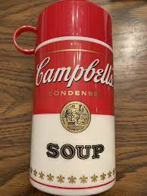

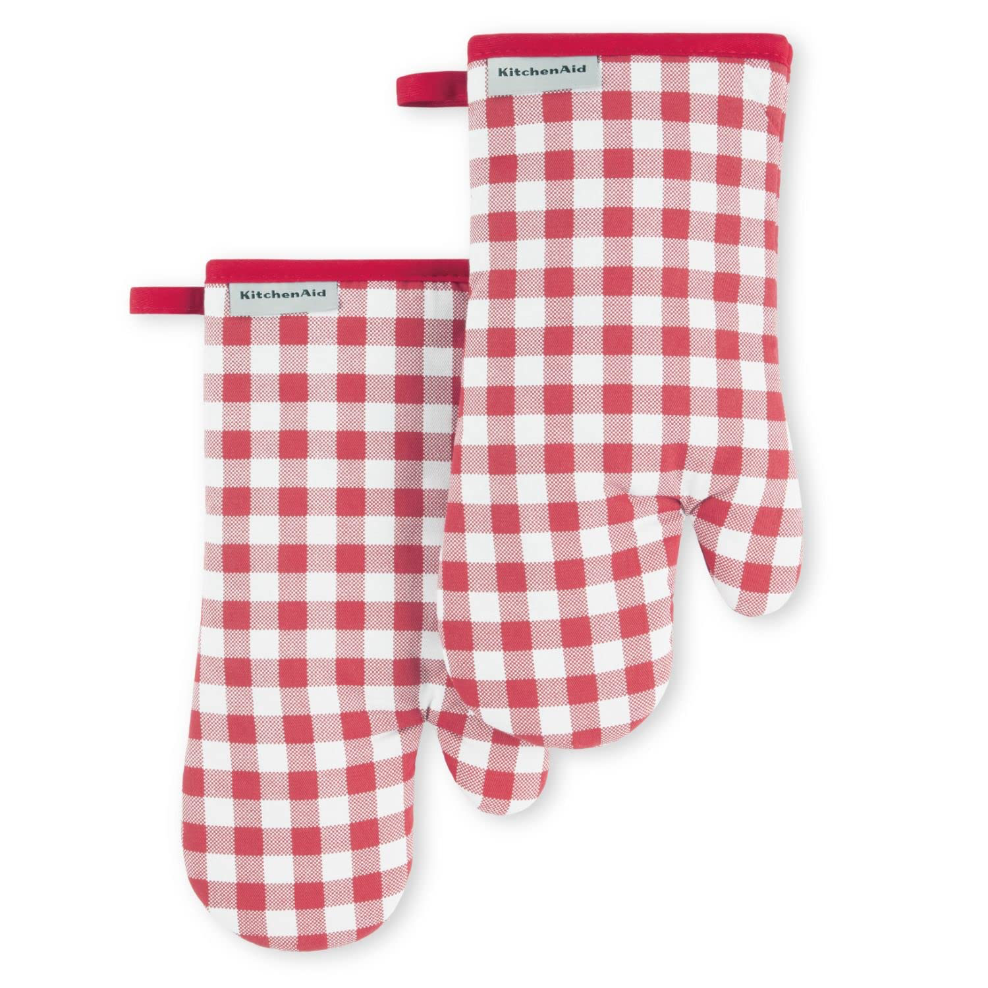
Merchandising
Bring back Thermostats!
High end soup bowls
Campbell’s apron, oven mitts, with brand colors and designs incorporated
Stickers

Slide 12
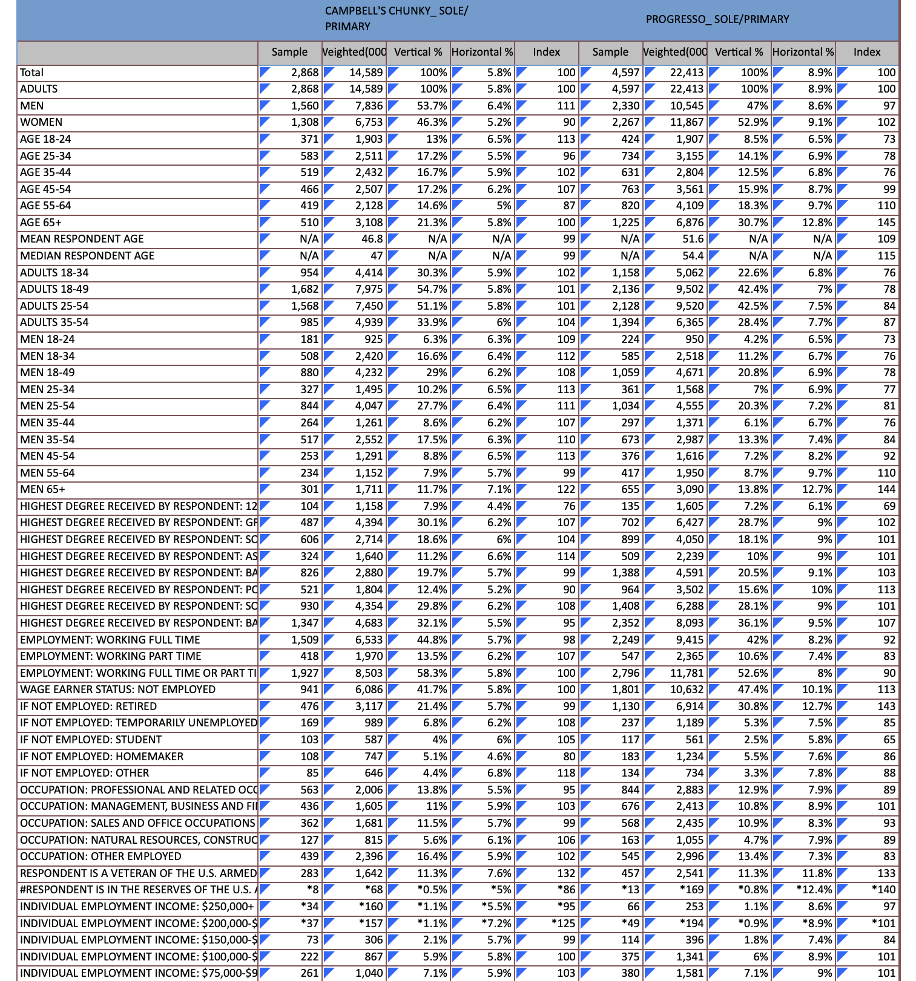
MRI SIMMONS

Slide 13
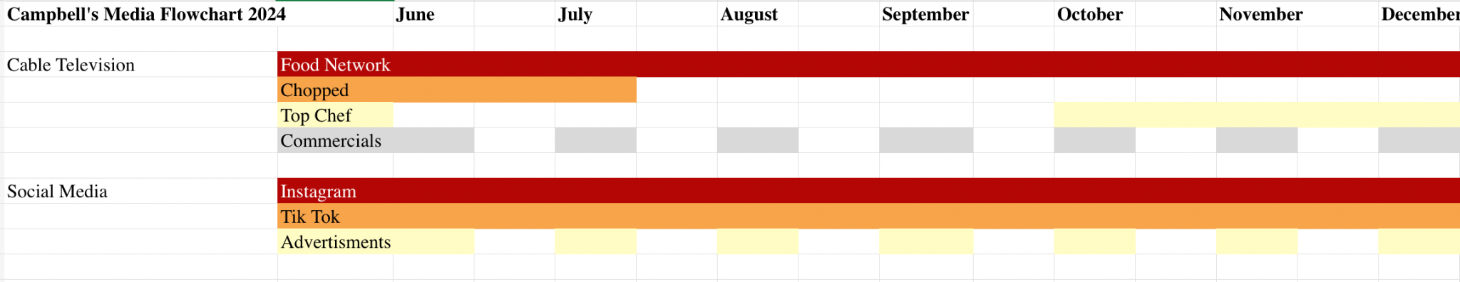
Flow chart

Slide 14
sources
Zulkosky, C. (2023, April 19). What convenience means to each generation of shoppers - the Food Institute. The Food Institute. https://foodinstitute.com/focus/what-convenience-means-to-each-generation-of-shoppers/#:~:text=Eighty%2Dseven%20percent%20of%20millennial,least%20compared%20to%20other%20generations
Campbell Soup Company. (2021, December 14). Campbell outlines next phase of strategy to drive profitable growth. https://www.campbellsoupcompany.com/newsroom/press-releases/campbell-outlines-next-phase-of-strategy-to-drive-profitable-growth/

